Slide 1
Image Formation and OpenGL
Sang Il Park
Dept. of Software

Slide 2
Objectives
Introduction
  image formation
  “classic” OpenGL vs. “new” OpenGL
Text book: Chapter 1.3~1.8

Slide 3
Image Formation

Slide 4
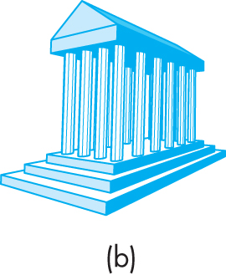
Elements of Image Formation
What do we need to see the following?

Slide 5
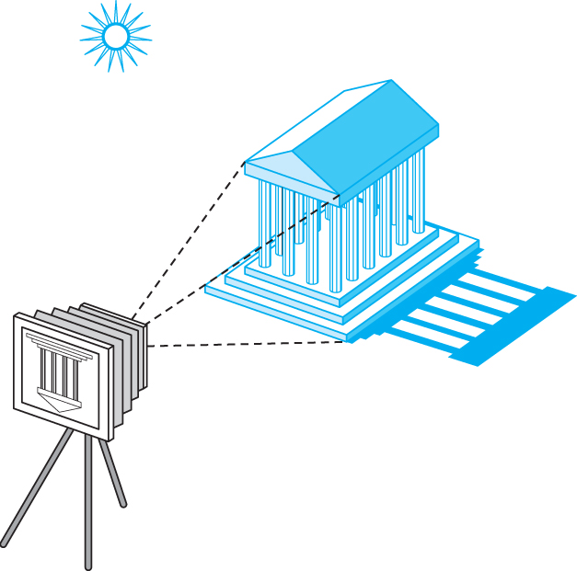
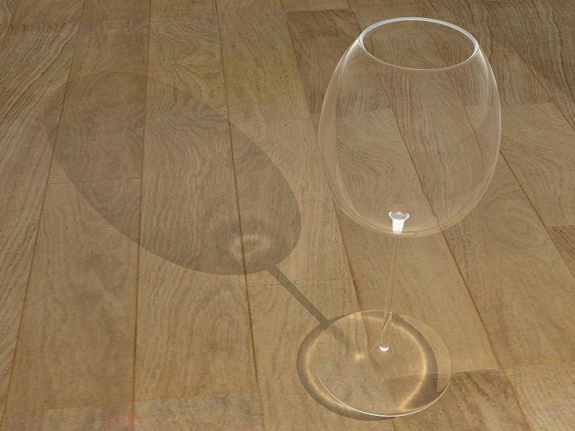
Elements of Image Formation
Objects
Viewer
Light source(s)
Attributes (materials)
  govern how light interacts with the materials in the scene
Attributes is getting more important

Slide 6
Separation is Important
Separation of objects, viewer, light sources, and attributes.
Leads to simple software API
  Specify objects, lights, camera, attributes
  Let implementation determine image
Leads to fast hardware implementation

Slide 7
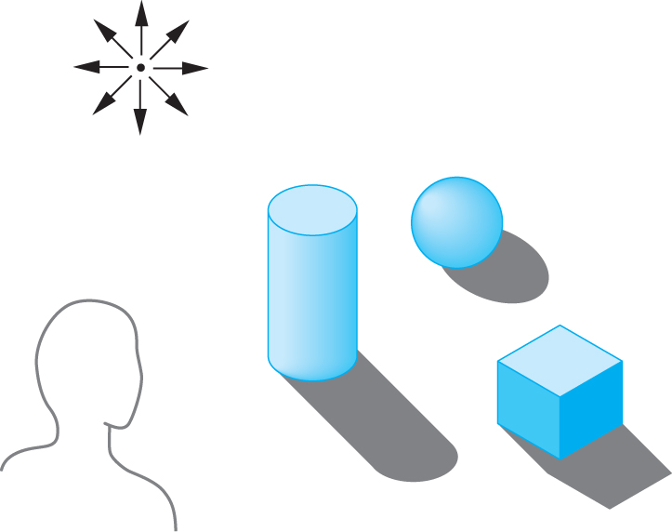
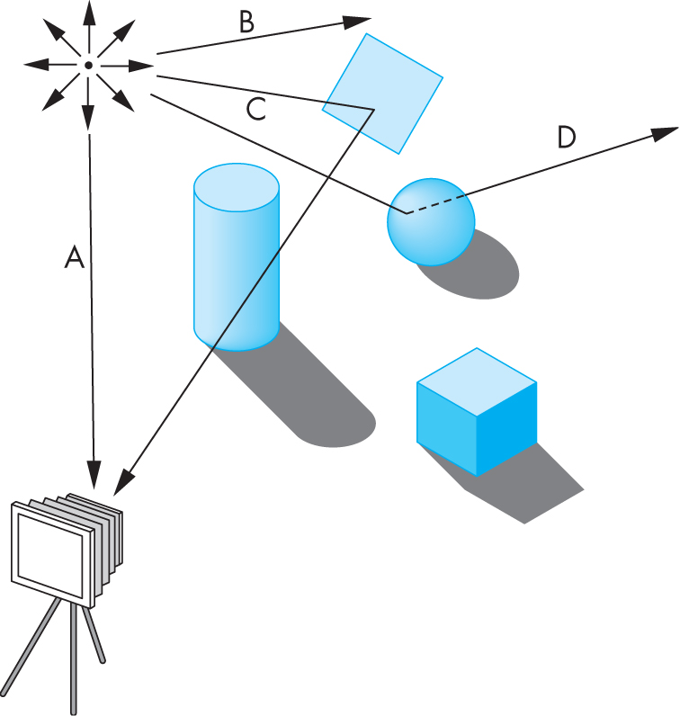
Determine the color
One way to form an image is to follow rays of light from the lights
each ray of light may have multiple interactions with objects

Slide 8
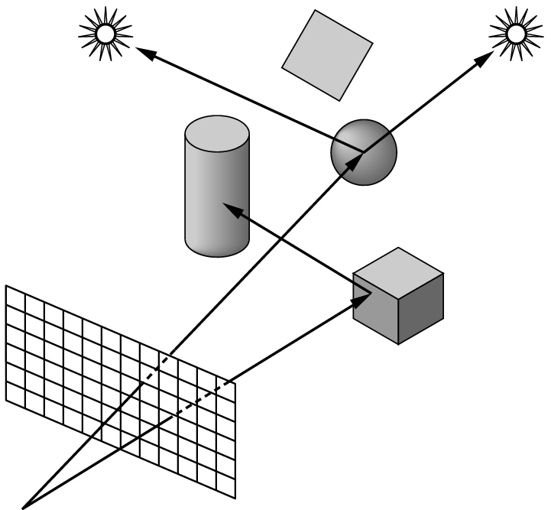
Ray tracing
Ray tracing: follow rays of light from center of projection until they either are absorbed by objects or go off to infinity
  Can handle global effects
    Multiple reflections
    Translucent objects
  Slow
  Must have whole data base
  available at all times

Slide 9
Why not ray tracing?
Ray tracing seems more physically based so why don’t we use it to design a graphics system?
Possible and is actually simple for simple objects such as polygons and quadrics with simple point sources
In principle, can produce global lighting effects such as shadows and multiple reflections but ray tracing is slow and not well-suited for interactive applications
Now, Ray tracing with GPUs is close to real time
  http://www.rigidgems.sakura.ne.jp

Slide 10
“Simplified” Practical Approach
Process objects one at a time in the order they are generated by the application
  Can consider only local lighting
Pipeline architecture
All steps can be implemented in hardware on the graphics card
E. Angel and D. Shreiner: Interactive Computer Graphics 6E © Addison-Wesley 2012

Slide 11
Vertex (vertices) Processing
Much of the work in the pipeline is in converting object representations from one coordinate system to another
  Object coordinates
  Camera (eye) coordinates
  Screen coordinates
Every change of coordinates is equivalent to a matrix transformation
PROJECTION
E. Angel and D. Shreiner: Interactive Computer Graphics 6E © Addison-Wesley 2012

Slide 12
Rasterization
If an object is visible, the appropriate pixels in the frame buffer must be assigned colors
Rasterizer produces a set of fragments for each object
Fragments are “potential pixels”
  Have a location in frame bufffer
  Color and depth attributes
Vertex attributes are interpolated over objects by the rasterizer

Slide 13
Fragment Processing
Fragments are processed to determine the color of the corresponding pixel in the frame buffer
Colors can be determined by texture mapping or interpolation of vertex colors
Fragments may be blocked by other fragments closer to the camera
  Hidden-surface removal

Slide 14
OpenGL: the API

Slide 15
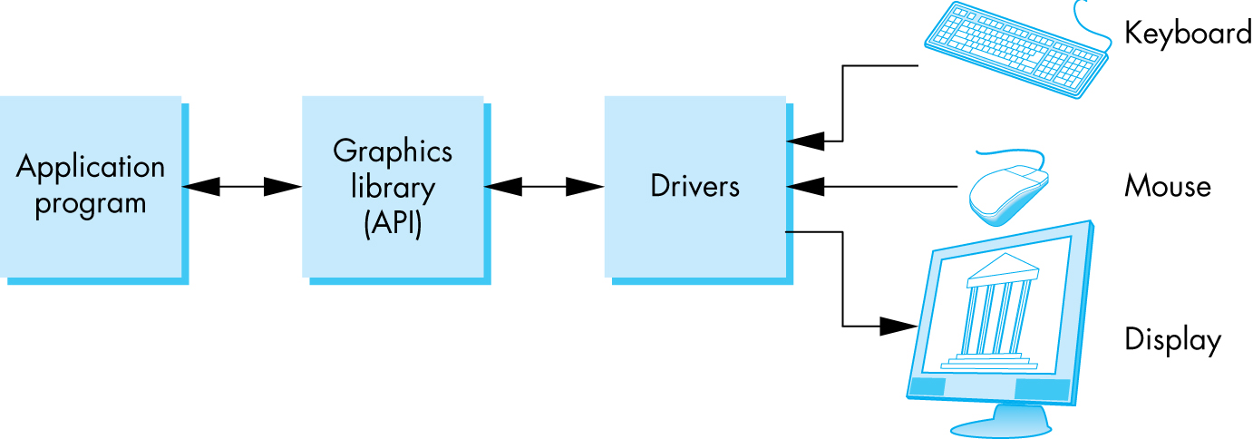
The Programmer’s Interface
Programmer sees the graphics system through a software interface: the Application Programmer Interface (API)

Slide 16
API Contents
Functions that specify what we need to form an image
  Objects
  Viewer
  Light Source(s)
  Attributes (Materials)
Other information
  Input from devices such as mouse and keyboard
  Capabilities of system
E. Angel and D. Shreiner: Interactive Computer Graphics 6E © Addison-Wesley 2012

Slide 17
Object Specification
Most APIs support a limited set of primitives including
  Points (0D object)
  Line segments (1D objects)
  Polygons (2D objects)
  Some curves and surfaces
    Quadrics
    Parametric polynomials
All are defined through locations in space or vertices
E. Angel and D. Shreiner: Interactive Computer Graphics 6E © Addison-Wesley 2012

Slide 18
Object Specification (old style)
type of object
location of vertex
glBegin(GL_POLYGON)
glVertex3f(0.0, 0.0, 0.0);
glVertex3f(0.0, 1.0, 0.0);
glVertex3f(0.0, 0.0, 1.0);
glEnd( );
end of object definition
E. Angel and D. Shreiner: Interactive Computer Graphics 6E © Addison-Wesley 2012

Slide 19
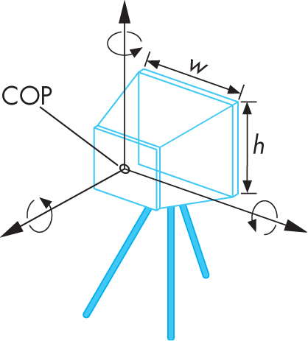
Camera Specification (old style)
Six degrees of freedom
  Position of center of lens
  Orientation
Lens
Film size
Orientation of film plane
→ glPerspective(…), gluLookAt(…)
E. Angel and D. Shreiner: Interactive Computer Graphics 6E © Addison-Wesley 2012

Slide 20
Lights and Materials (old style)
Types of lights
  Point sources vs distributed sources
  Spot lights
  Near and far sources
  Color properties
Material properties
  Absorption: color properties
  Scattering
    Diffuse
    Specular
→ glLight(…), glMaterial(…)

Slide 21
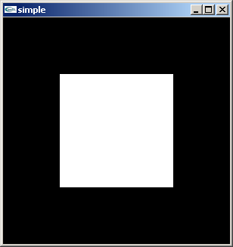
A Simple Program ( old style)
Generate a square on a solid background
E. Angel and D. Shreiner: Interactive Computer Graphics 6E © Addison-Wesley 2012

Slide 22
Let’s start to CODE it!
Preparation
Download necessary libraries
  Header files: Include folder
  LIB files : lib folder
  DLL files : bin(or system32) folder
Change the project setting
  Directory setting

Slide 23
Required Libraries
freeglut: http://freeglut.sourceforge.net/
GLEW: http://glew.sourceforge.net/
I put both of them and more at our homepage:
freeglut_and_glew.zip
➔ Download it and unzip it at “c:/cg2/”

Slide 24

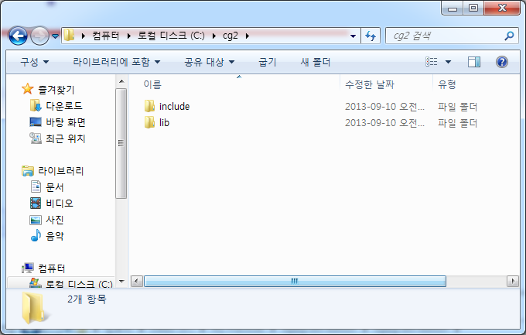
What you should have in your “c:/cg2/” folder:

Slide 25
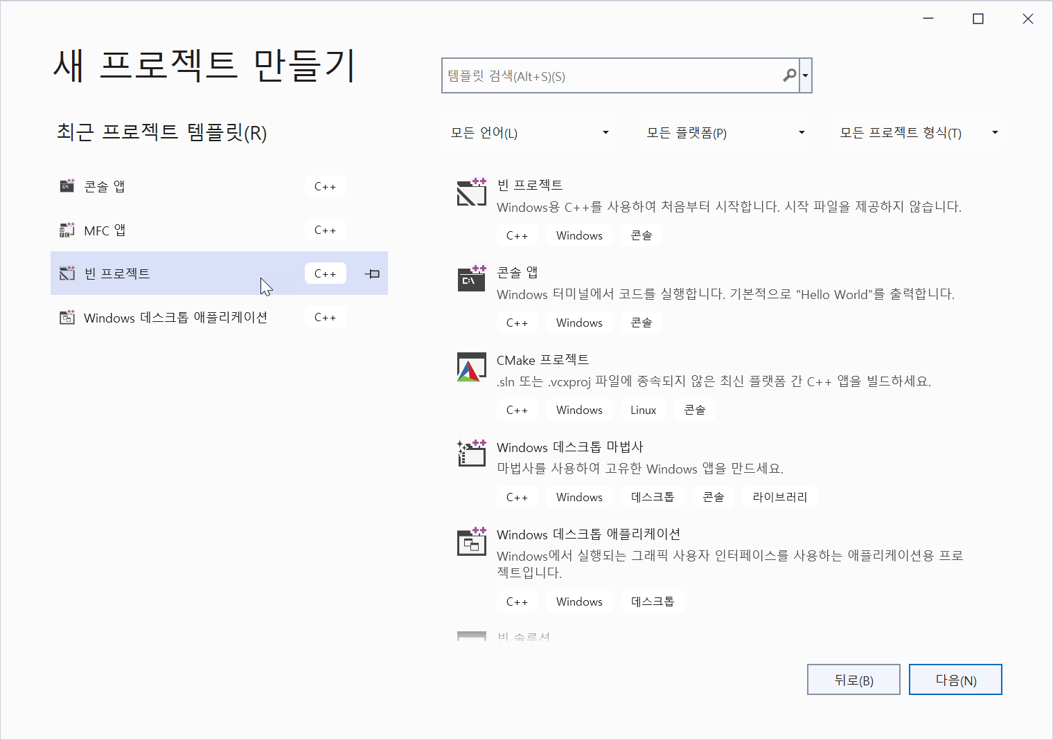
Project Setting:
Start a new project with a
“console application” project
with an empty project option.

Slide 26
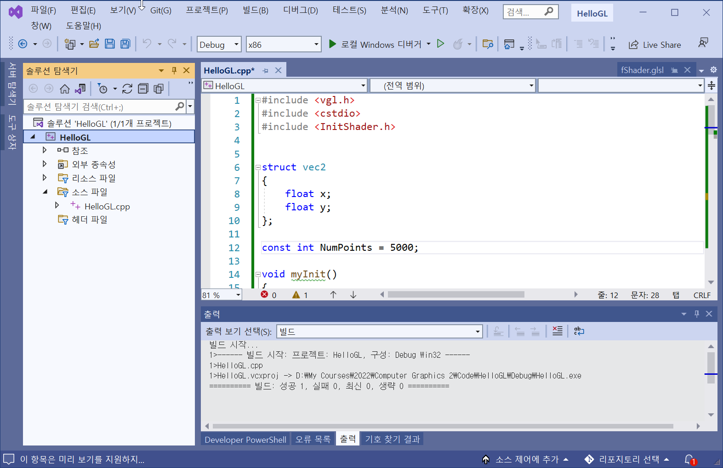
Set Target Platform: x86
다음과 같이 반드시 Target Platform을 x86으로 설정 (x64 아님!)

Slide 27
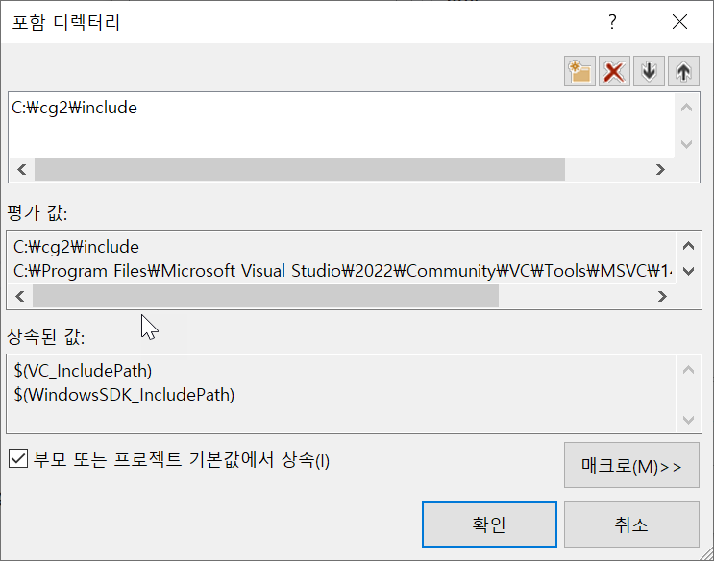
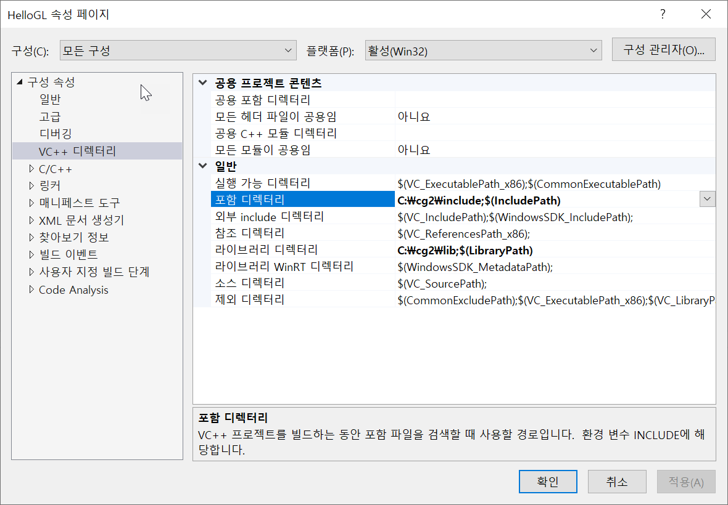
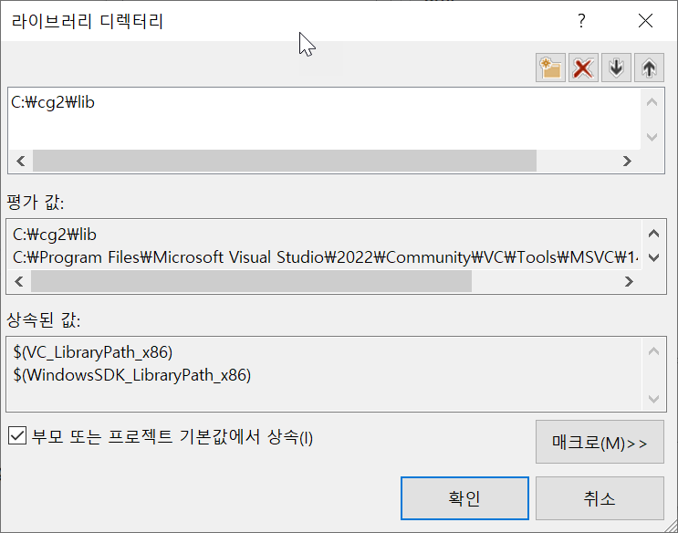
Project Setting
Set the directories:

Slide 28
Create a new main.cpp file
And add the following line at the beginning of the code:
#include <vgl.h>
Now ALL SET!!!!

Slide 29
Hello GL Program:
#include <vgl.h>
void display()
{
glClear(GL_COLOR_BUFFER_BIT);
glBegin(GL_TRIANGLES);
glVertex2f(-0.5, -0.5);
glVertex2f(0.5, -0.5);
glVertex2f(-0.5, 0.5);
glVertex2f(0.5, -0.5);
glVertex2f(0.5, 0.5);
glVertex2f(-0.5, 0.5);
glEnd();
glFlush();
}
int main(int argc, char** argv)
{
glutInit(&argc, argv);
glutInitDisplayMode(GLUT_SINGLE | GLUT_RGBA);
glutInitWindowSize(512, 512);
glutCreateWindow("Hello GL");
glutDisplayFunc(display);
glutMainLoop();
return 0;
}

